Slide 1


Introduction to
Robotic Process Automation
WhatsApp Bot
Your Register No. 220701097
Name : Janani J
Guide Name : Mrs. J. Jinu Sophia
Designation and Department : Assistant Professor (SG)

Slide 2
Abstract
The WhatsApp Bot, developed using UiPath Studio, automates message scheduling by prompting users for a contact name or phone number, message content, and a specified date and time for delivery. The bot efficiently searches for the contact on WhatsApp and sends the message at the scheduled time, ensuring timely communication without manual intervention. This solution enhances user convenience by streamlining repetitive messaging tasks.

Slide 3
Need for the Proposed System
The need to automate repetitive messaging tasks, minimize manual labor, and guarantee timely communication is what drives the development of the suggested WhatsApp Bot system. It tackles the problem of communicating at precise times, which is important for announcements, reminders, and planned updates. This system reduces the chance of missing crucial communications, increases productivity, and saves time by enabling users to easily pre-schedule messages. It also provides a smooth way for people and companies to effectively manage their messaging schedules.

Slide 4
Advantages of the Proposed System
Automates message scheduling, ensuring timely delivery.
Offers a user-friendly interface for easy scheduling.
Improves communication consistency for reminders and updates.
Increases convenience by handling multiple scheduled messages.
Reduces human errors in sending scheduled messages.
Enhances productivity with efficient communication management.

Slide 5
Literature Survey
Paper 1: WhatsApp bot and Robotic Process Automation
ADVANTAGES: 1. Automates a business process effectively.
2. Reveal tasks in a stipulated time.
DISADVANTAGE: 1. Dependent on WhatsApp’s interface, so any changes could disrupt the bot.
Paper 2: Robotic Process Automation (RPA) for reducing teaching workload
ADVANTAGES: 1. Provides Intelligent automation.
2. Performs Repetitive Tasks.
DISADVANTAGE: 1. Limited to scheduling, making it unsuitable for complex or real-time interactions.

Slide 6
Main Objective
The WhatsApp Bot project's primary goal is to automate the process of sending pre-planned messages to designated contacts. Users can enter a phone number or contact name, the message's content, and the preferred delivery date and time using the bot. After that, it looks up the contact on WhatsApp automatically and makes sure the message is sent at the right time, increasing efficiency and eliminating the need for manual message management.

Slide 7
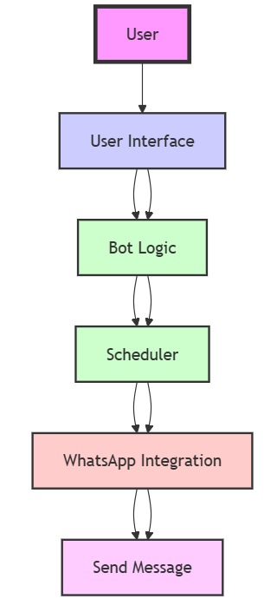
Architecture

Slide 8
System Requirements
Software:
UiPath Studio for building and automating the bot workflows.
WhatsApp Web for message delivery.
Windows OS to run UiPath Studio and the bot.
Hardware:
Processor: Intel i3 or higher.
RAM: Minimum 4GB.
Storage: 1GB of free disk space for software and bot files.
Internet Connection: Stable connection for WhatsApp and bot functionality.

Slide 9
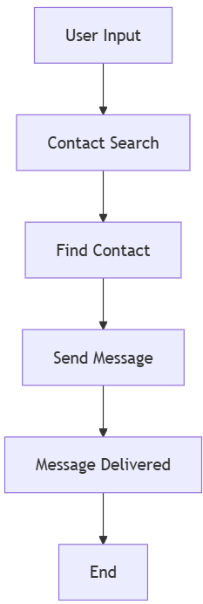
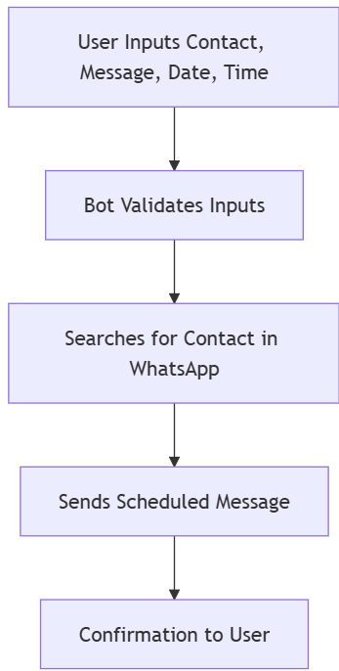
Functional Description
Name of the Module 1: Message Scheduling
  Short description: Automates scheduling and sending WhatsApp messages.
DFD / Activity Diagram:
Name of the Module 2: Contact Search and Message Delivery.
  Short description: Searches for contacts and sends messages automatically.
DFD / Activity Diagram:

Slide 10
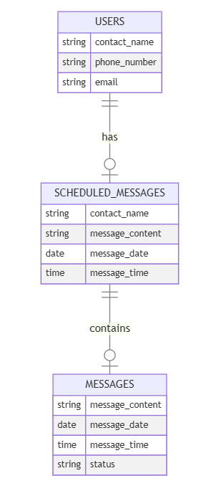
Table Design
ER Diagram:

Slide 11
Process Design
Main Process:
User inputs contact information (name/phone number), message, date, and time for scheduling.
The bot verifies the information, searches for the contact, and schedules the message to be sent at the specified time.
Sub Process:
Collecting user input (contact, message, time).
Validating and storing data.
Searching for the contact on WhatsApp and scheduling the message.

Slide 12
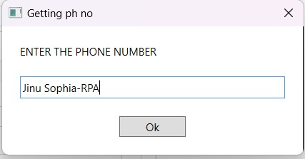
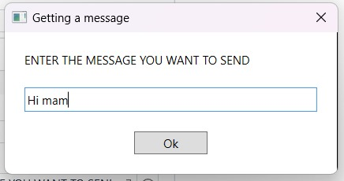
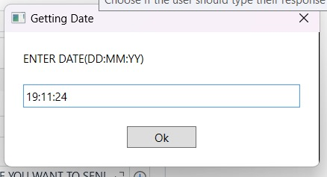
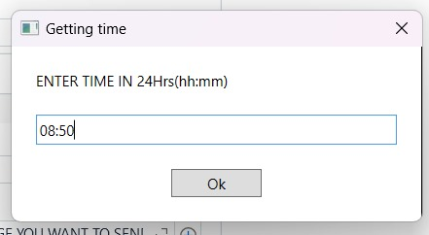

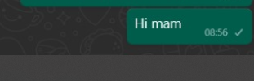
Implementation
Module 1: User Input Collection
  Captures user inputs for contact details, message content, scheduled date, and time using prompts.
Module 2: Contact Search & Validation
  Automates searching for the specified contact on WhatsApp to validate its existence before scheduling the message.

Slide 13
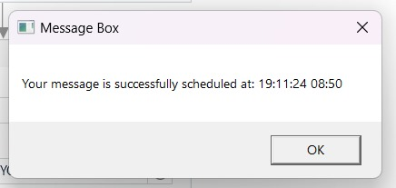
Testing
Verify the bot's functionality by inputting various phone numbers, messages, dates, and times to ensure accurate scheduling and delivery of WhatsApp messages as per user-defined parameters.
Screen shots

Slide 14
Conclusions
In conclusion, the WhatsApp Bot effectively automates the scheduling and delivery of messages, ensuring timely communication without manual intervention. By reducing repetitive tasks, it enhances productivity and streamlines messaging management. This solution offers a reliable, efficient tool for personal and business use, optimizing message delivery processes.

Slide 15
Future Enhancement
Description 1: Integrating NLP could allow the bot to understand and personalize messages based on context, improving the user experience by making the bot more interactive.
Description 2: Adding multimedia support would enable sending various types of content, such as images or voice notes, making the system more versatile for both personal and business communications.

Slide 16
IEEE Paper
Title: Multi-Channel Chatbot and Robotic Process Automation
Authors: Gota Dan; Domuta Claudiu; Fanca Alexandra; Pop-Puscasiu Adela; Stan Ovidiu; Valean Honoriu
Publisher: IEEE
Title: Adopted Acceptance Test-Driven Development (ATDD) to produce Robotic Process Automation (RPA) for reducing teaching workload
Authors: Nuttaporn Phakdee; Wantana Sisomboon; Jirayus Arbking
Publisher: IEEE

Slide 17
References
Journals
UiPath Community Forum - WhatsApp Automation.
UiPath Chatbots.
UiPath WhatsApp API Integration.

Slide 18
Queries
1. How does the bot ensure accurate message delivery at the specified time?
The bot uses the user-provided date and time as a trigger and continuously compares the current system time with the scheduled time. Once they match, the bot executes the message-sending workflow to ensure timely delivery.
2. Are there any limitations to using UiPath for automating WhatsApp messaging?
Yes, limitations include dependency on internet connectivity, compatibility with the WhatsApp application, and restrictions set by WhatsApp's terms of use, which may prohibit automation in certain cases.

Slide 19
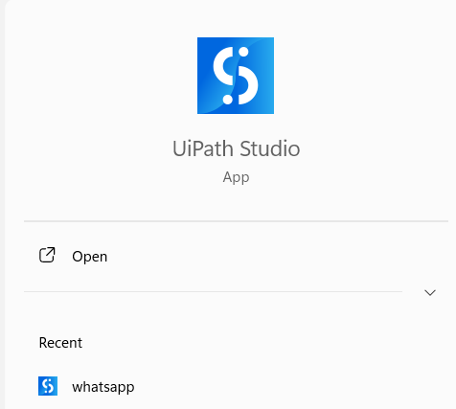
Demonstration
Step1: Open UiPath Studio and Run the Workflow

Slide 20
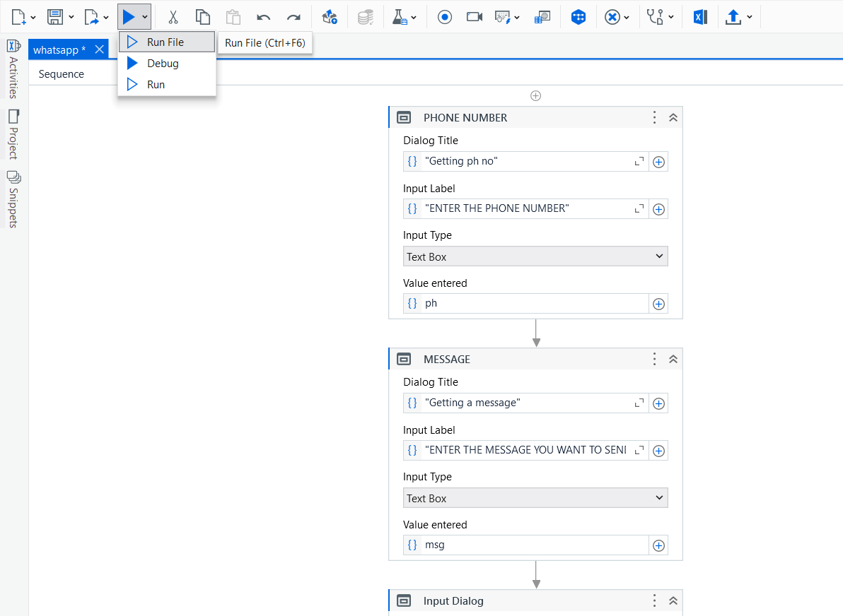
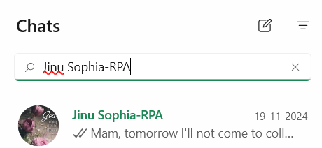
Step 2: Input Values
Step 3: Contact Search
Step 4: Message Delivery

Slide 21
Thank You

